Slide 1


Notes:
use this sheet to open your presentation

Slide 2

PreTeXt, PreFigure, and the production of braille math books
David Austin, Grand Valley State University
Alexei Kolesnikov, Towson University
Tactile Reading and Graphics Conference
June 2, 2025
Note: This is a PowerPoint version of the slides. There is a web version of the talk available here: gvsu.edu/s/3cC

Slide 3
What is PreTeXt?
An authoring system for scholarly documents: books, articles, teaching materials, slideshows, …
Open source and freely available
Originates in the mathematics community but now used in many disciplines, such as computer science, physics, engineering, music theory, economics, college writing, and children’s books
A vibrant community of authors, developers, researchers, and instructors

Slide 4
PreTeXt philosophy
“Write once, read anywhere”
From a single source, a document can be rendered in
HTML, fully accessible with a screenreader,
PDF (with possible intermediate LaTeX source),
EPUB (with math rendered as images, or MathML, or speech),
BRF (paginated or for refreshable displays).
An author focuses on the content and structure of the document rather than presentation.
No accessibility expertise is required of the author.

Slide 5
Writing PreTeXt source
PreTeXt source is written in XML. All content is contained in nested tags, with attributes, that describe the document’s structure.
The next slide contains an example of PreTeXt XML code for a theorem

Slide 6
<theorem xml:id="theorem-pythagoras">
<title>Pythagorean theorem</title>
<statement>
<p>Let <m>\triangle ABC</m> be a right triangle. Suppose that <m>c</m> is the length of the side opposite the right angle and <m>a</m>, <m>b</m> are the lengths of two other sides. Then <me> a^2 + b^2 = c^2 </me>. </p> </statement>
<proof> <p> See Euclid. </p> </proof>
</theorem>

Slide 7
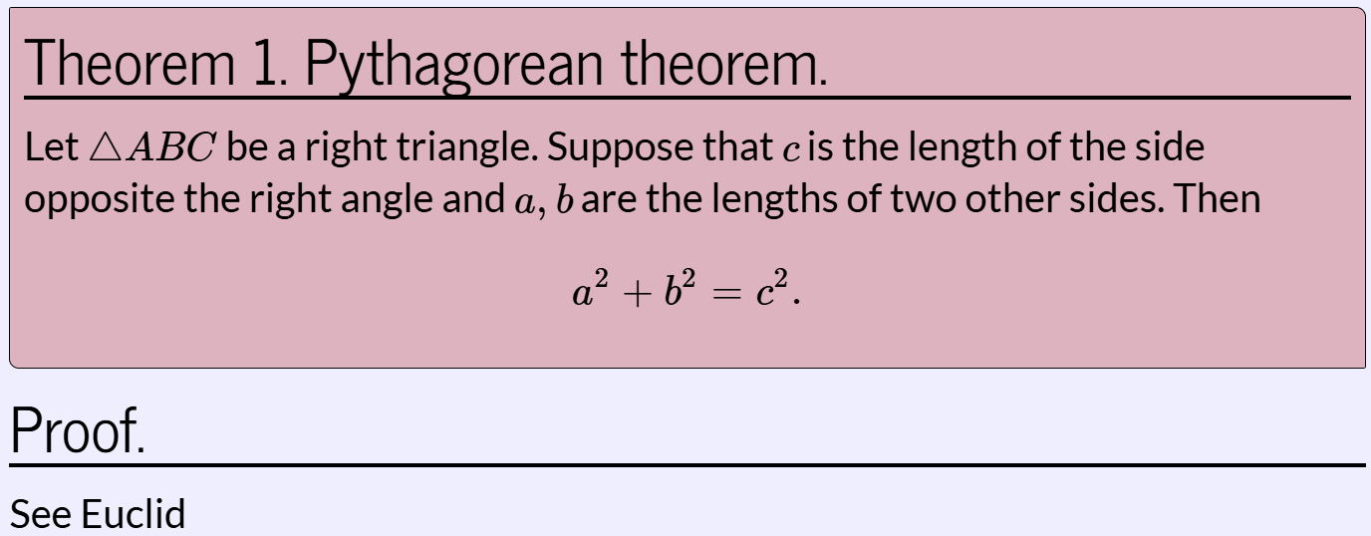
Appearance in a slideshow

Slide 8
Mathematical diagrams
PreFigure, an authoring system for accessible mathematical diagrams, is to figures what PreTeXt is to text. (Workshop tomorrow at noon!)
Standalone software yet fully integrated into PreTeXt.
From a single source, an author can create annotated SVGs, PDFs, and tactile diagrams.

Slide 9
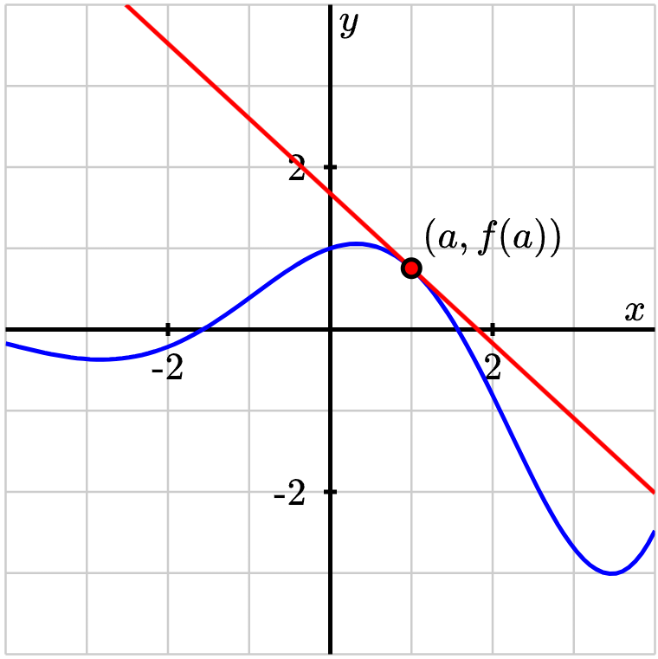
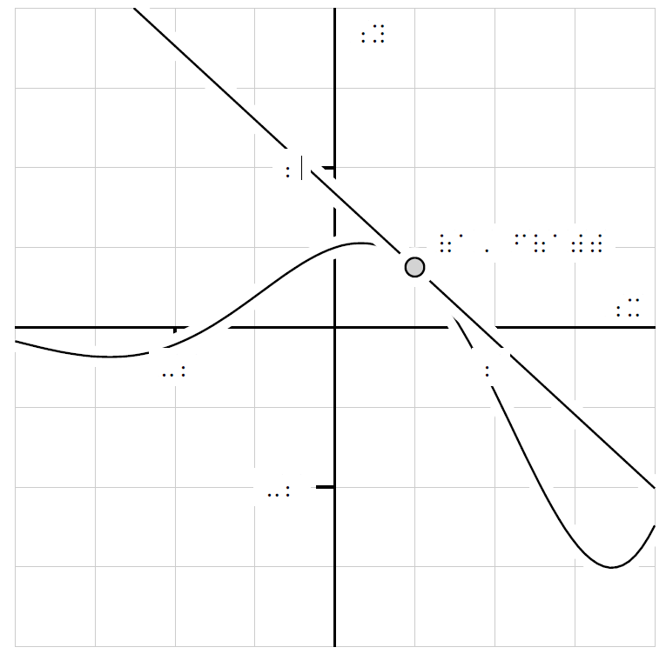
Mathematical diagrams

Slide 10
Braille conversions
Conversion of PreTeXt source into BRF is automated.
Mathematics is processed by MathJax so that math is rendered in Nemeth braille and navigable with a screenreader.

Slide 11
7777777777777777777777777777777777777777
,!orem #a ,py?agor1n !orem4
,let _% $t ,a,b,c _: 2 a "r triangle4
,suppose t ;c is ! l5g? ( ! side
opposite ! "r angle & a1 ;b >e ! l5g?s (
two o!r sides4 ,!n
_%
a~2"+b~2 .k c~2
_:4
,pro(4 ,see ,euclid
gggggggggggggggggggggggggggggggggggggggg

Slide 12
Braille conversions to date
Tom Judson, Abstract Algebra and Applications.
Matt Boelkins, Active Prelude to Calculus.
David Austin, Understanding Linear Algebra.
Use case: screen reader, refreshable Braille display, tactile graphics

Slide 13
Resources
GitHub codespace, a cloud environment used by many newcomers to PreTeXt.
PreTeXt home page, with documentation and samples.
PreTeXt Sample article, including demonstrations of most features with sample PreTeXt source.
MathTech.org, a blog about uses of PreTeXt and its accessibility features
Google groups (from low volume to high): pretext-announce, pretext-support, pretext-dev

Slide 14


